Slide 1
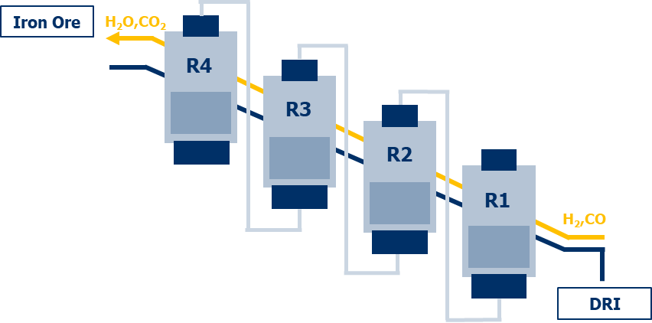
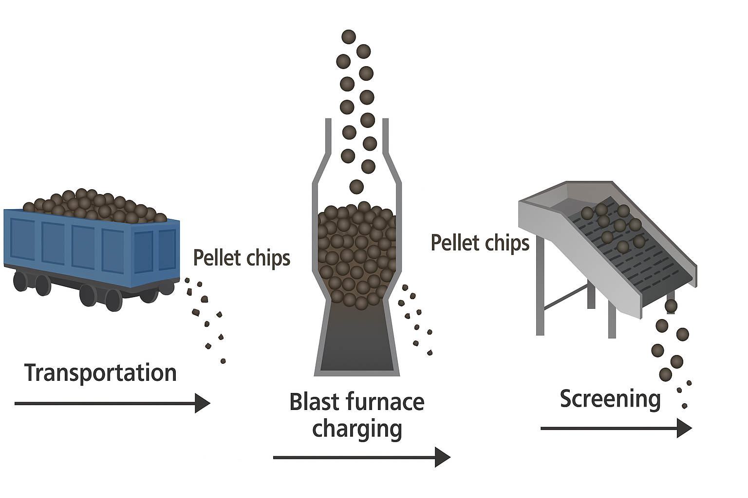
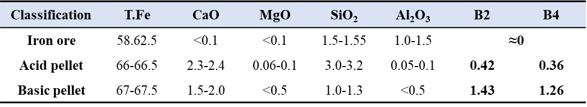

Synergy btw. FINEX and BF in an integrated Steel Mill
Fluidized Bed Reactor (FBR) Multi-stage reduction process
≤8mm
5-6 wt%
Pellet fines
generation
+
Pellet
fines
(≤5mm)
Pellet fines
(≤5mm)
Pellet fines
Use Directly
Use Directly
(≤5mm)
Pellet fines
Synergy
Table. Assumed Mass balance of pellet fines in POSCO (2024)
B2: CaO/SiO₂
B4: (CaO+MgO)/(SiO₂+Al₂O₃)
Improvement of Assimilation bevior compromising R.D
[Advantages]
① Directly using iron ore fines
- (without prior agglomeration)
[Challenges]
① Smelting properties
- Assimilation ability with Flux
Unit (ton/year) | Value ton/year | Note
Total Pellet Utilization | 3,290,252 | Total process
Pellet fines generation in process | ≈213,867 | Size (≤5mm)
Pellet fines generation After High-MgO pellet employment (Low mechanical strength) | >213,867
Assimilation ▲
Melting
Assimilation ▼
Reduction behavior
Lower T_{m}
High T_{m}

