Slide 1
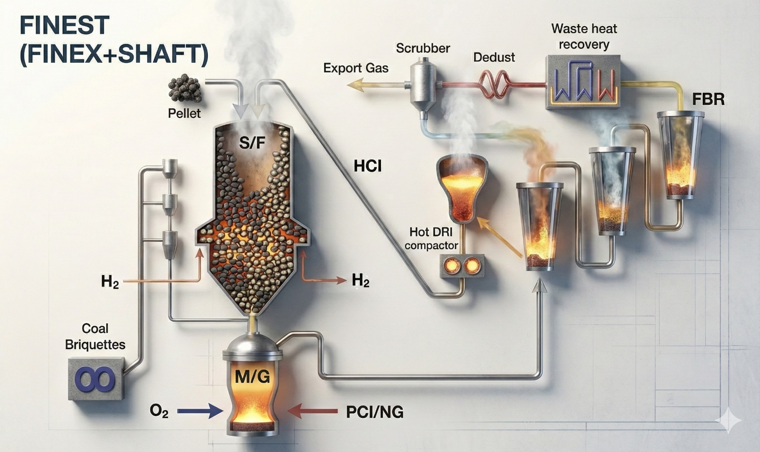
The FINEX®+SHAFT Dual-Reactor
Dual-Reactor
(FINEX®+SHAFT)
(Hot Compacted Iron)
Pellet +HCI
Fig. Concept of FINEX®+SHAFT dual-reactor process

