Slide 1





COOLSTAR* Project (Dec. 2017 ~ Feb. 2025)
※ COOLSTAR: CO₂ Low emission technology of Steelmaking And hydrogen Reduction
○ Project Overview
Government-led
Project
Ministry of Trade, Industry and Energy
- Companies : POSCO, HYUNDAI Steel,..
- Universities, Research Institutes
○ Target : Develop technologies to reduce CO₂ emissions(direct/indirect) by 15% in steelworks
Sub 1
Hybrid ironmaking technology based on BF
- H₂ enriched gas injection
- Application of low reduced iron
Sub 2
H₂ amplification based on by-product gas
LRI production
Sinter
By-product gas
(H₂ bearing gas)
Fluidized bed
reduction
• Low-Reduced Iron
• Reducibility : 65~70 %
• Direct Reduction ↓
Hot compacting
Sub 3
BOF/EAF improvement based on substitution raw material
COG
(H₂ 56%, CH₄ 26%)
LRI
Coke re-design
for H₂ reduction
C rate ↓
BOF
• Replacing C by H₂
• BF H₂ reduction↑
Coke Oven
Coke
H₂-HBI
H₂ containing gas
tuyere injection
EAF
H₂

Slide 2
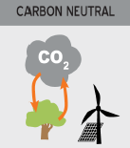
Sub 1 Project_Hybrid Ironmaking technology based on BF
Technology Structure
Target: Develop Pilot Technologies to reduce CO₂ Emissions by 10% in Ironmaking Process
Direct reduction 1 : Technology converting byproduct gas to reductant (CO₂ Δ7%)
Indirect reduction:
Waste heat recovery/
CO₂ utilization (CO₂ Δ2%)
LRI manufacturing/charging technology
Exhaust gas(CO₂)
Byproduct Gas
(Hydrogenous Gas)
Conversion to
reducing gas
Fluidized
bed
• Low-Reduced Iron(LRI)
• Reduction degree : 65∼70 %
• Decrease direct reduction
CO₂ utilization
• COG, FOG
COG
(H₂ 56%, CH₄ 27%)
• Synthesis/electrochemical
conversion
• CO₂ → Chem./Fuel
LRI
C reduction
Coke Oven
• Improvement of
reduction efficiency
• Replacement of
C by H₂
Coke and sinter production technology
Coke
Exhaust heat recovery
Sinter
plant
Sinter
• low/middle temp. exhaust
heat exchange
Injection technology of hydrogenous gas
• Replacement of C by H₂
• Increase indirect reduction
Biomass injection technology
Molten
iron
• Use biomass, C neutral
as H₂ source
Biomass
Direct reduction 2 : Biomass application
technology (CO₂ Δ1%)

Slide 3
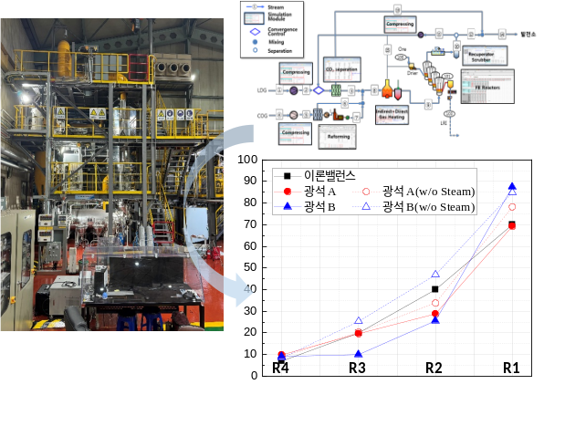
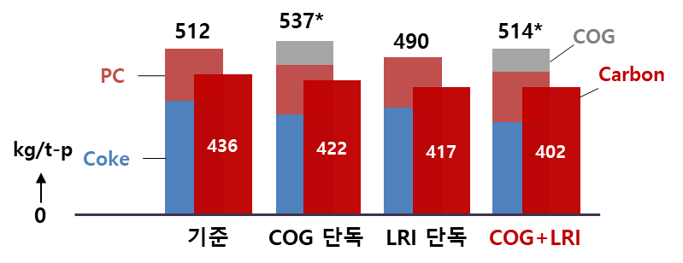
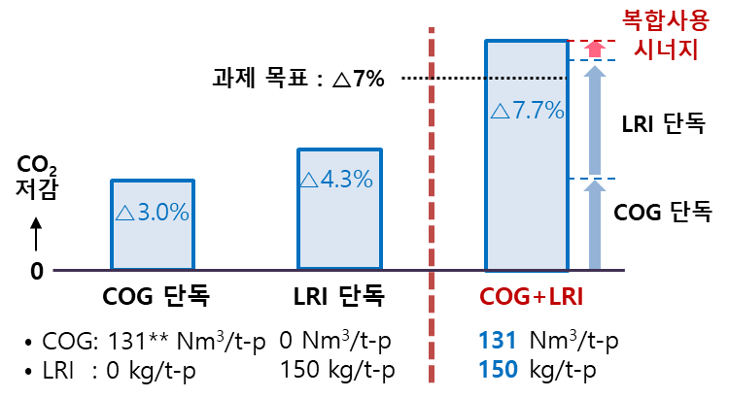
Sub 1 Project_Hybrid Ironmaking technology based on BF
Main Results
⬥ Sinter and Coke Manufacturing Technology
- Develop the sinter with high reduction degree using SiO₂, size of limestone, and mixing method of coarse particle
- Develop the high strength coke using the increase of coal rank and bulk density of coal blend
⬥ Pilot-scale Fluidized Bed Reactor (PFBR) for LRI Manufacturing : > 65%(RD)
- Design and construct the PFBR with dimension of 0.3m I.D., 3.3m height, 50 kg
- Operate the PFBR using multi-step method to simulate a multi-stage FBR
(R4, R3, R2, R1) with a single FBR
- Produce LRI with more than 78% of RD for Australian and Brazilian Ores
⬥ COG Injection and LRI Charging Technology
- Develop a mathematical model for BF based on heat and mass balance
- Implement the tests in a BF shaft reaction tester(IReS) with reaction conditions calculated by model
- Avg reduction degree of burden material is higher using COG/LRI simultaneously
- In case of simultaneous COG injection/LRI charging, carbon consumption significantly decreases, and
CO₂ reduction effect is 7.7% It is slightly higher than that of individual case of COG injection and LRI charging
[Overview of PFBR]
Synergy
Effect
Target
CO₂
Reduction
[RAR]
[CO₂ Reduction Effect]

Slide 4
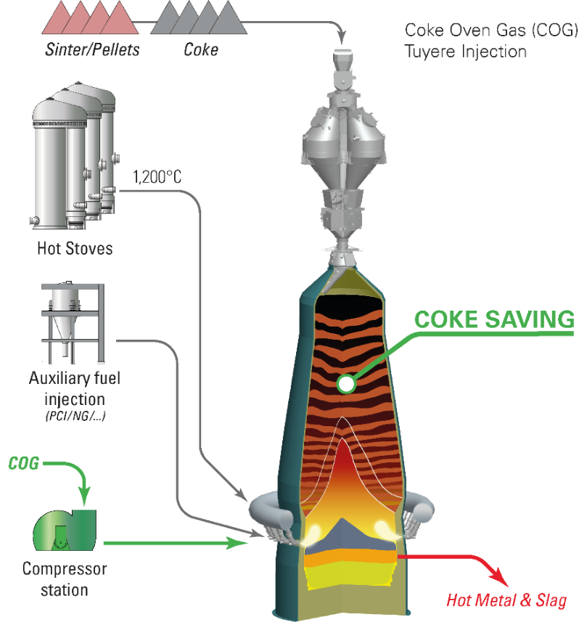

COOLSTAR^{X} (Apr. 2025 ~ Dec. 2030)
Future Project
○ Background
- Plan a national project to substantiate the key results of COOLSTAR project(P phase) in commercial BF
- Demonstrate the reduction of RAR in commercial BF(Ph No. 2) through H₂ rich gas injection and alternative
iron charging
DRI, HBI
LRI, Scrap
Sinter/Pellet
Coke
○ Roadmap
’25.4
’27.12
‘30.12
1200℃
Construction for injection/charging facilities
Design of the operating parameters of BF
No. 2 BF Test
Hot Stove
Coke Oven
- BF : 2650 Nm³ (Pohang No. 2, POSCO)
- Targets
. Test of H₂ rich gas injection : ≥ 65 Nm3/t-p
. Alternative iron charging : 5 %
- Analysis of BF operation and CO₂ emissions reduction
PCI
COG
Compressor
Pig Iron/Slag
NG Tank

