Slide 1
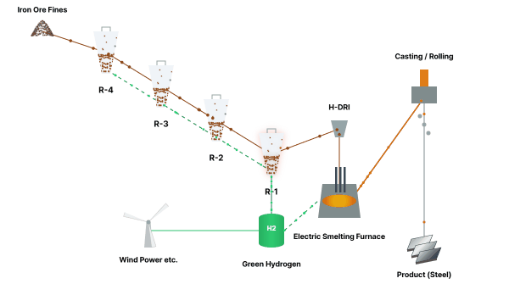
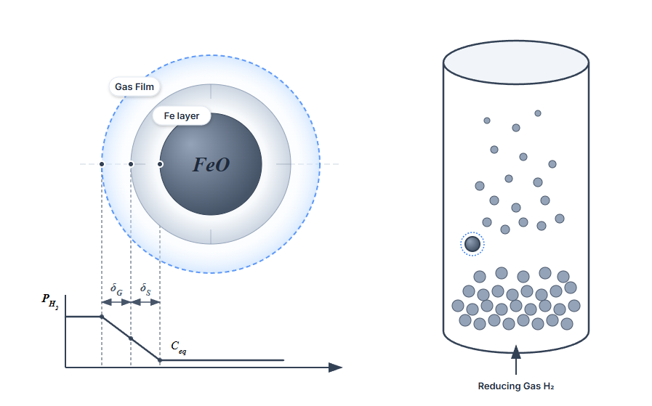
Modeling and Simulation for HyREX Hydrogen-Based Ironmaking
■ Research Objectives
The study aimed to provide a reliable engineering tool to predict chemical reduction efficiency and heat-flow behavior, moving beyond simple empirical data to a physics-based simulation approach.
■ Research period
September 2022 ~ September 2026
■ Core Technical Achievements
Advanced Resistance Network: Implemented a refined resistance model (Gas Film, Diffusion, Chemical Reaction) covering 10 detailed reaction pathways.
RTD-Kinetics Integration: Developed a methodology to quantify the efficiency gap between batch and continuous reactors resulting from non-ideal back-mixing.
Exceptional Accuracy: Achieved FeO reduction degree error margin of only less than 2% compared to experimental data.
Flow Regime Optimization: Identified stable gas velocities for Bubbling, Turbulent, and Fast fluidization to maximize gas-solid contact efficiency.

