Slide 1


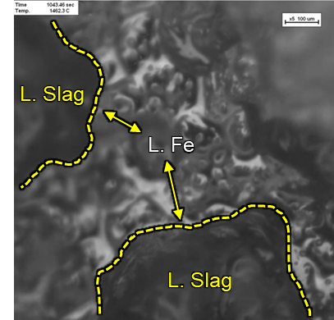

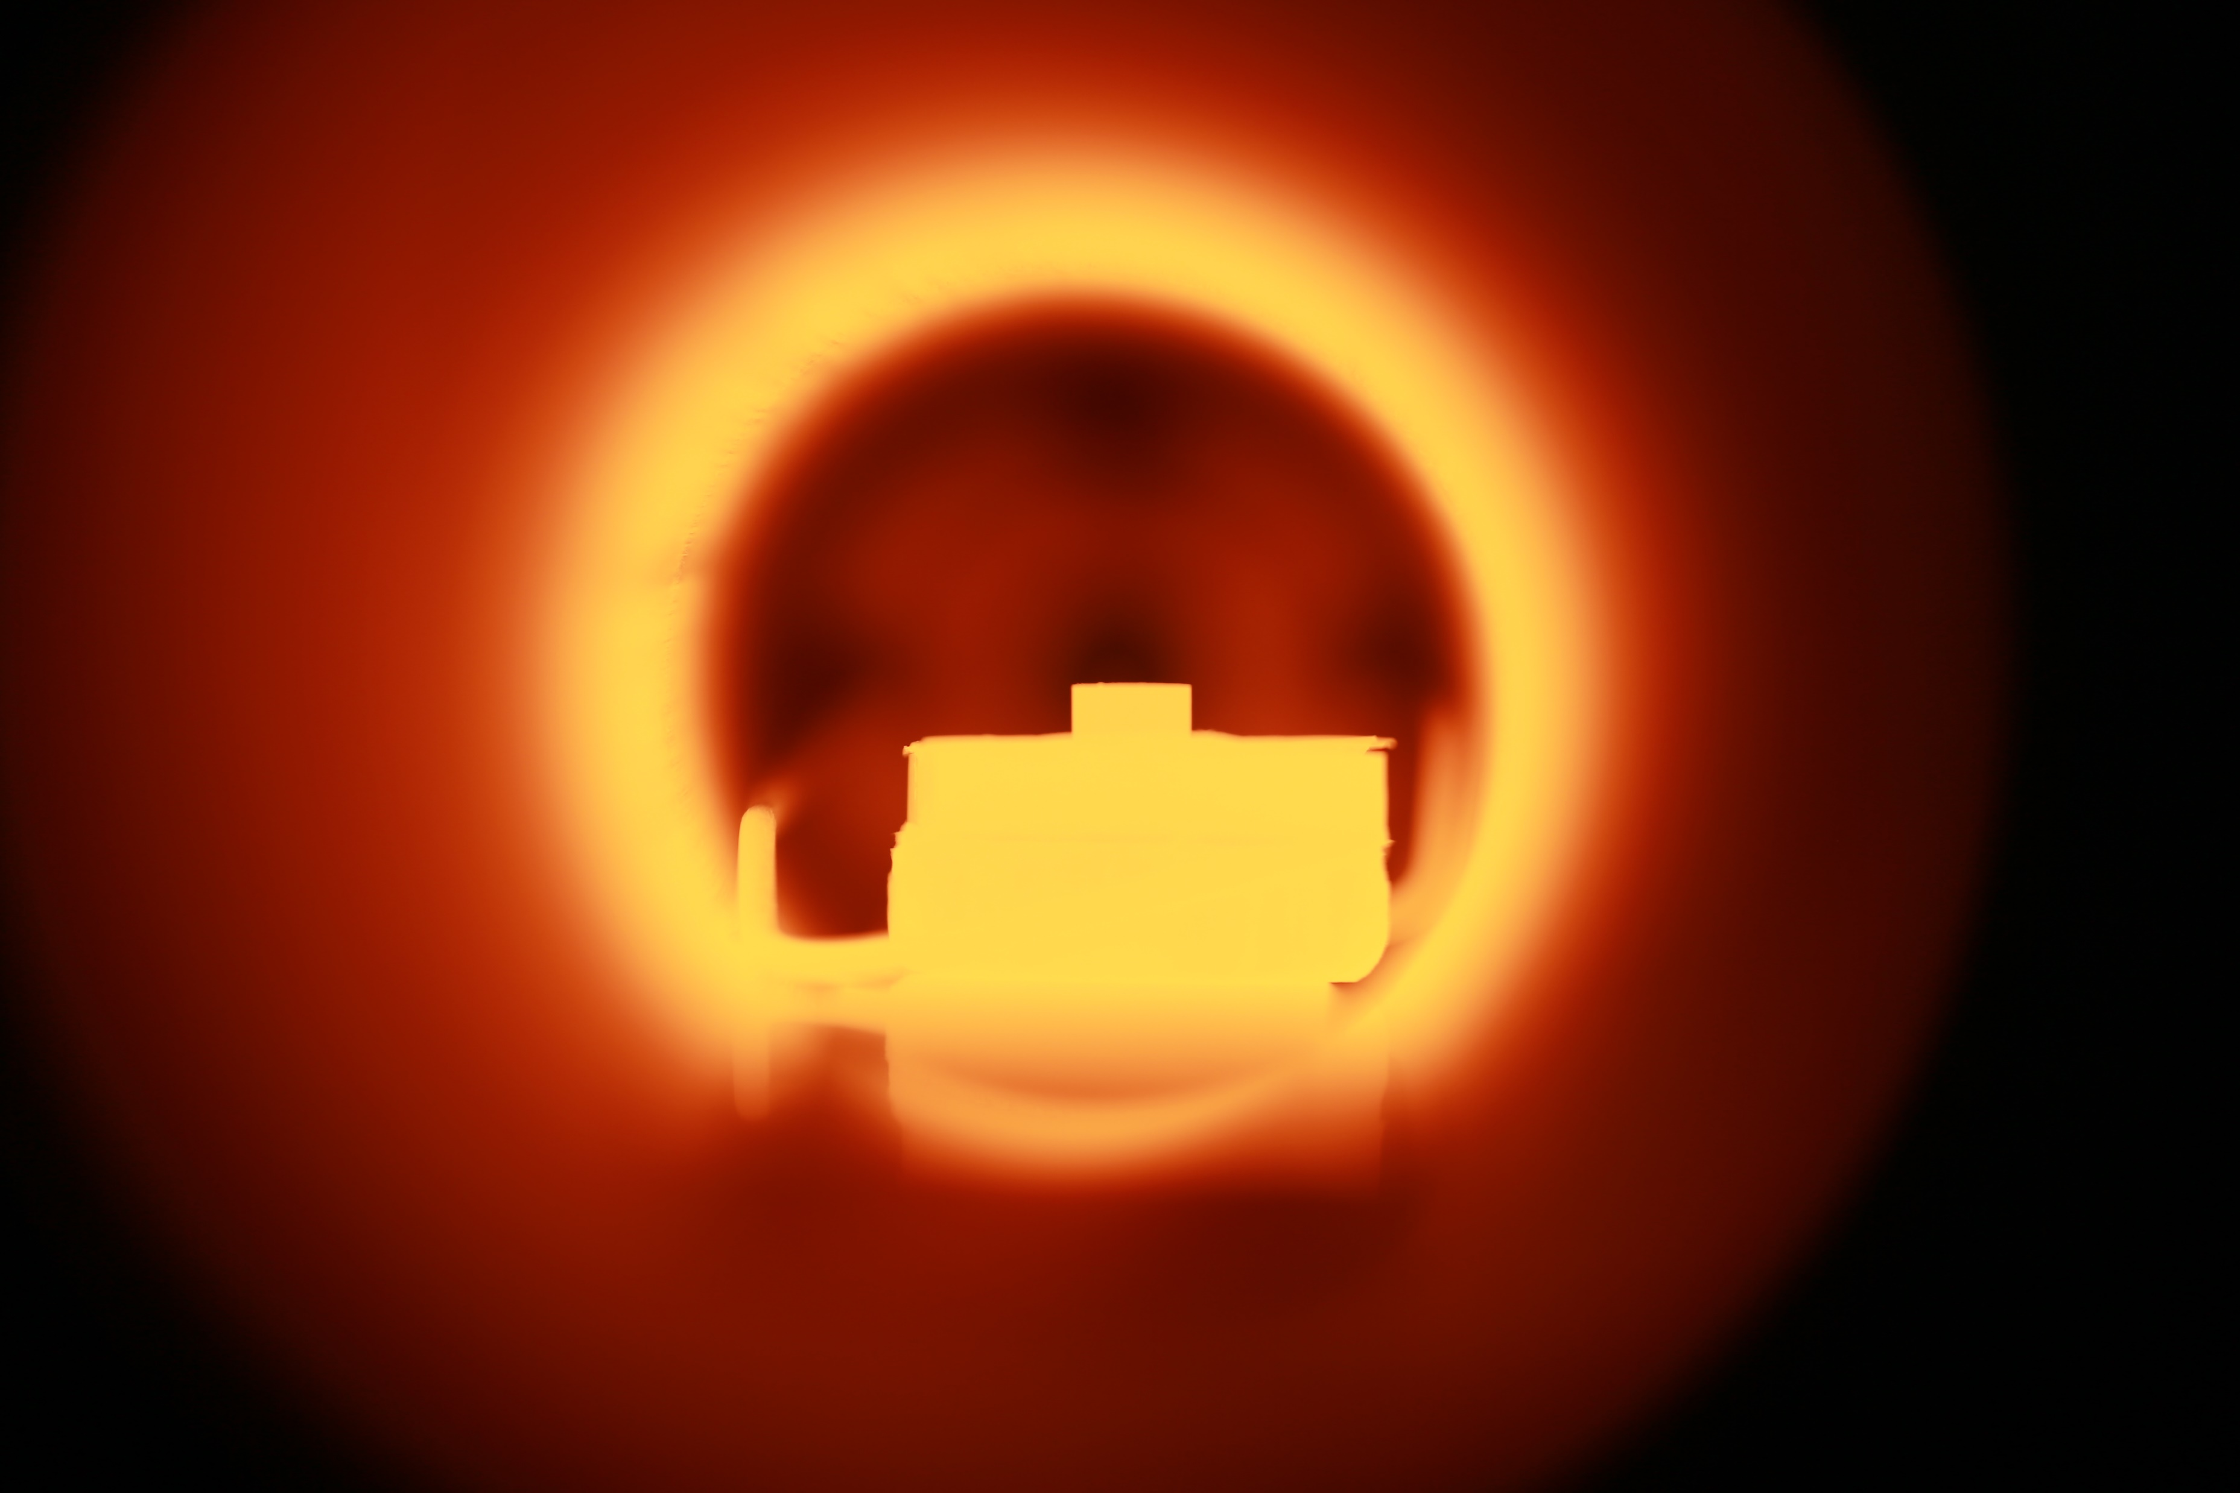

Basic design development of electric smelting furnace
for hydrogen reduction ironmaking process
Supported by
(2023.07 ~ 2025.12)
1. INVESTIGATION
2. VERIFICATION
3. SUGGESTION
Carbon source effect in
Electric Smelting Furnace (ESF)
Melting behavior of
carburized H₂-DRI at high T
Collapse mechanism of H₂-DRI containing carbon and flux
HOW?
HOW?
HOW?
Thermodynamic forecasting
Morphology observation
In-situ tracking of melting path
In-situ melting
Macro-scale
Micro-scale
Ex-situ shape
Carburization
Slag formation in ESF
= Ash + Gangue + Flux
Fluxing
From carbon source
ACTIONS
ACTIONS
ACTIONS
Thermodynamic Prediction of
Carburization effect on
Design of carbon and flux to
Ash effect on slag properties
De-S, De-P by ESF slag
Melting temperature of H₂-DRI
Maintenance of gangue
Promote melting of H₂-DRI
Control gangue and ash

