Slide 1
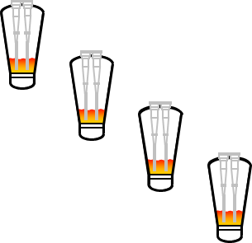



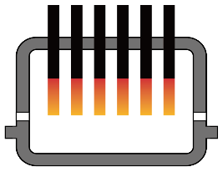


Hydrogen Ironmaking - HyREX®
HyREX® Process
* HyREX®: Hydrogen Reduction
Impurity
Removal
Sinter Feed
O₂
Steel
Hot DRI
BOF
Fluidized Bed
Reactors
Hot Metal
Fe₂O₃+3H₂→2Fe+3H₂O
Slag
H₂
ESF
Cement Industry
Hydrogen
Heating
FINEX® Fluidized Bed Technology
Operational technology in large-scale ESF (SNNC)

